Slide 1
2-Mathematical Background
Yong Peng
2021/03/01

Slide 2
Contents & Objective
Contents
An extreme brief review to the probabilistic, statistics, and linear algebra
Objective
Recall some important concepts and theorems

Slide 3
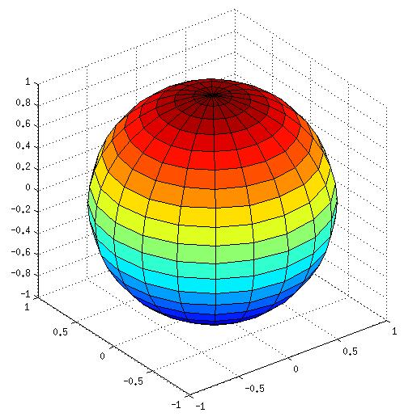
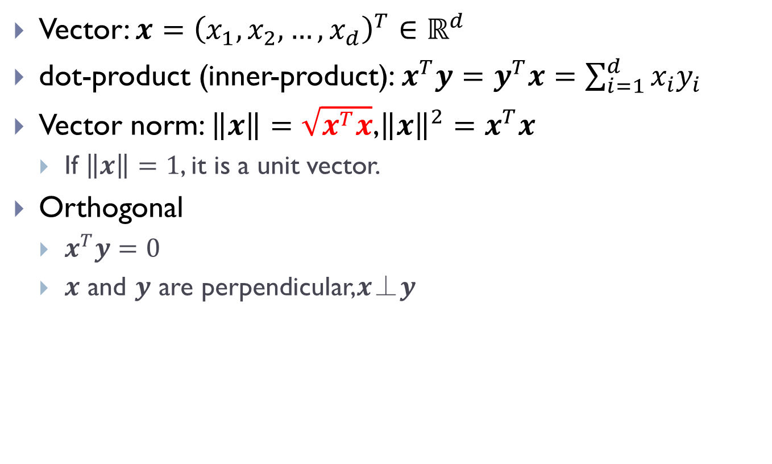
Linear algebra
Vector: $x={\left(x_{1},x_{2},…,x_{d}\right)}^{T}∈ℝ^{d}$
dot-product (inner-product): $x^{T}y=y^{T}x=\sum_{i=1}^{d}{x_{i}y_{i}}$
Vector norm: $\left\|x\right\|=\sqrt{x^{T}x}$,${\left\|x\right\|}^{2}=x^{T}x$
If $\left\|x\right\|=1$, it is a unit vector.
Orthogonal
$x^{T}y=0$
$x$ and $y$ are perpendicular,𝒙⊥𝒚

Slide 4
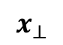
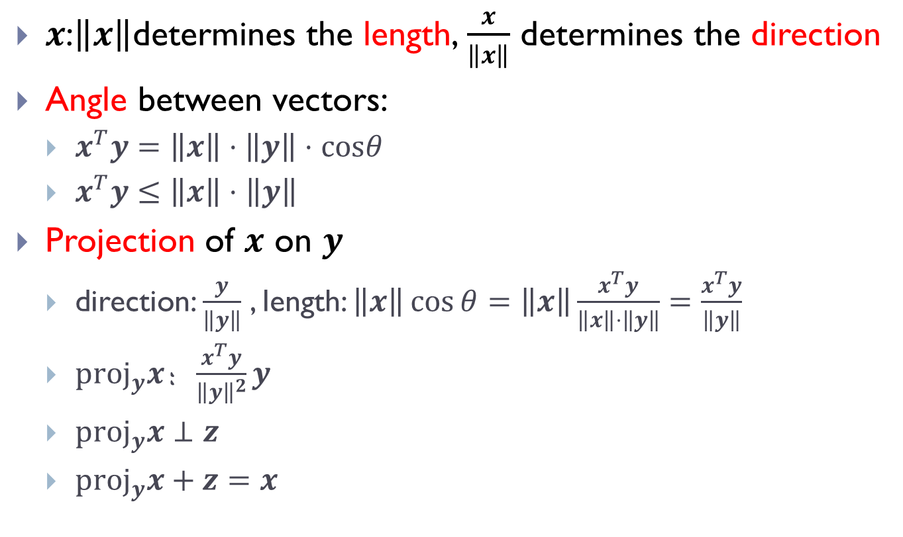
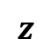
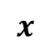

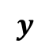
Linear algebra
$x$:$\left\|x\right\|$determines the length,$\frac{x}{\left\|x\right\|}$ determines the direction
Angle between vectors:
$x^{T}y=\left\|x\right\|⋅\left\|y\right\|⋅cosθ$
$x^{T}y≤\left\|x\right\|⋅\left\|y\right\|$
Projection of 𝒙 on 𝒚
direction: $\frac{y}{\left\|y\right\|}$ , length: $\left\|x\right\|\cos{θ}=\left\|x\right\|\frac{x^{T}y}{\left\|x\right\|⋅\left\|y\right\|}=\frac{x^{T}y}{\left\|y\right\|}$
$proj_{y}x$：$\frac{x^{T}y}{{\left\|y\right\|}^{2}}y$
$proj_{y}x⊥z$
$proj_{y}x+z=x$
$$x$$
$$z$$
$$θ$$
$$y$$
$$x_{⊥}$$

Slide 5
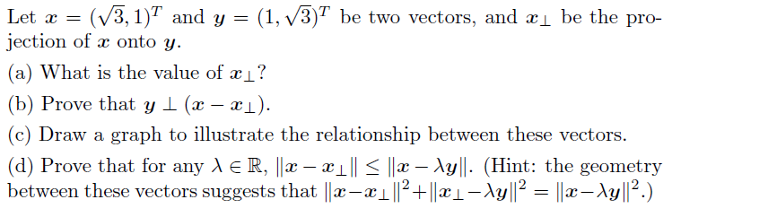
Linear algebra
Example

Slide 6
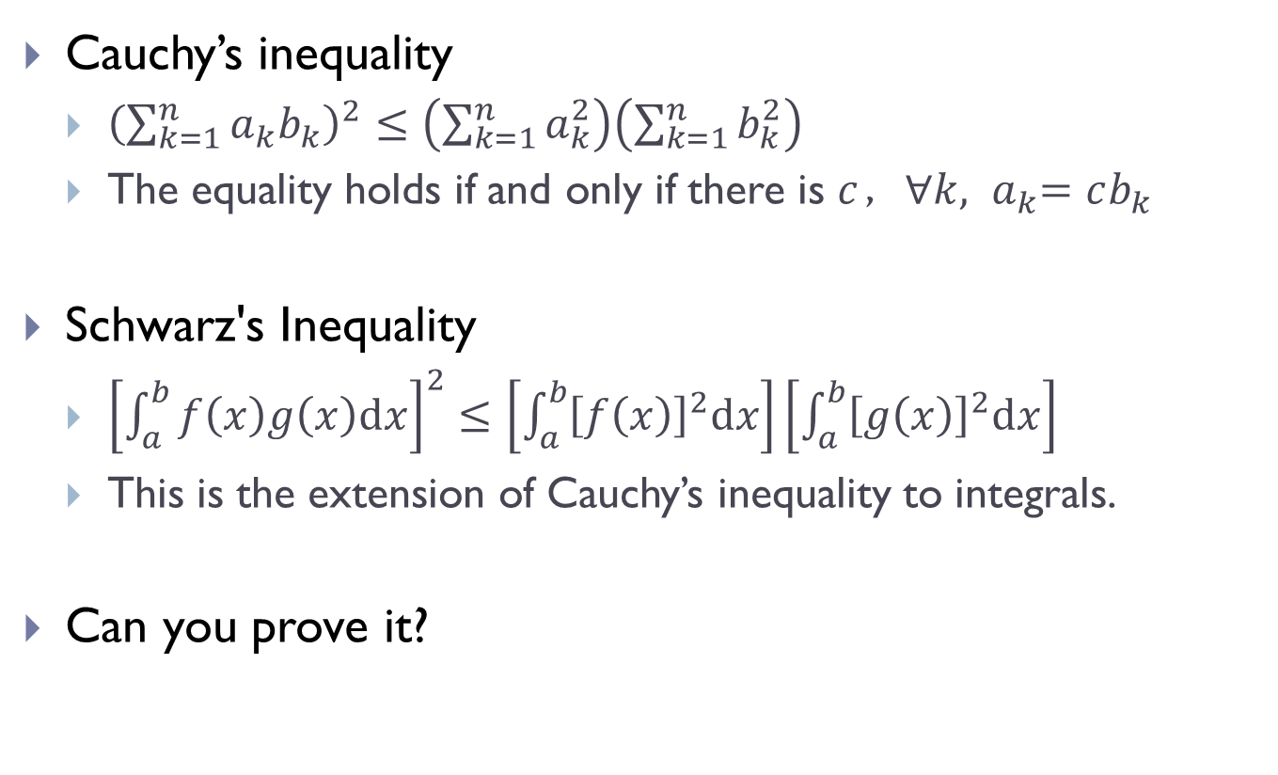
Linear algebra
Cauchy’s inequality
${\left(\sum_{k=1}^{n}{a_{k}b_{k}}\right)}^{2}≤\left(\sum_{k=1}^{n}{a_{k}^{2}}\right)\left(\sum_{k=1}^{n}{b_{k}^{2}}\right)$
The equality holds if and only if there is $c$，${∀k, a}_{k}=cb_{k}$
Schwarz's Inequality
${\left[\int_{a}^{b}{f\left(x\right)g\left(x\right)dx}\right]}^{2}≤\left[\int_{a}^{b}{{\left[f\left(x\right)\right]}^{2}dx}\right]\left[\int_{a}^{b}{{\left[g\left(x\right)\right]}^{2}dx}\right]$
This is the extension of Cauchy’s inequality to integrals.
Can you prove it?

Slide 7
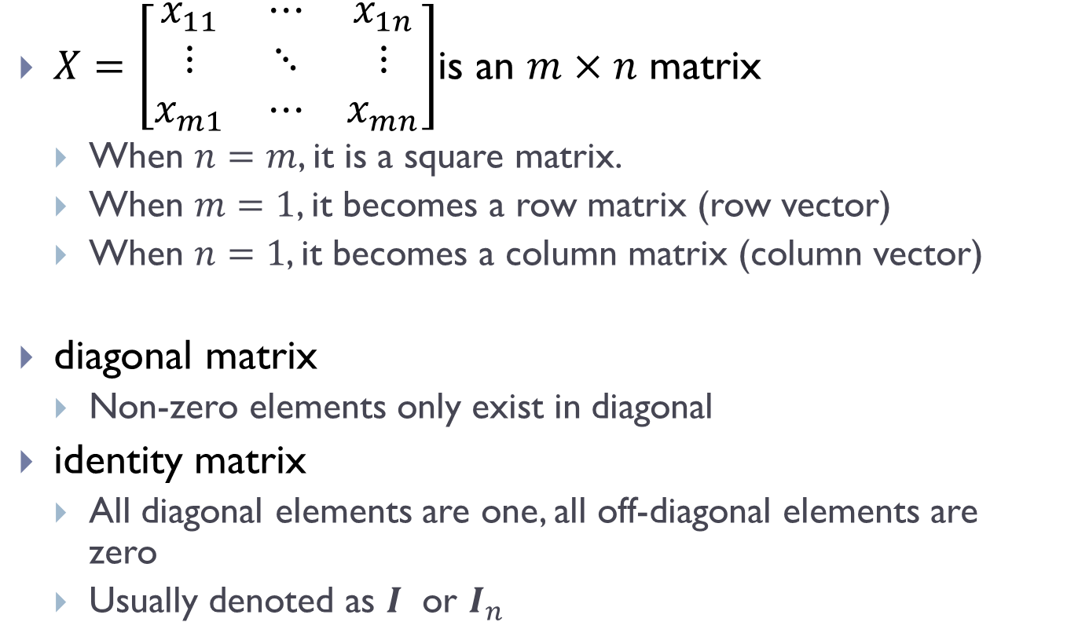
Matrix
$X=\left[\begin{matrix}x_{11} & ⋯ & x_{1n} \\ ⋮ & ⋱ & ⋮ \\ x_{m1} & ⋯ & x_{mn}\end{matrix}\right]$is an $m×n$ matrix
When $n=m$, it is a square matrix.
When $m=1$, it becomes a row matrix (row vector)
When $n=1$, it becomes a column matrix (column vector)
diagonal matrix
Non-zero elements only exist in diagonal
identity matrix
All diagonal elements are one, all off-diagonal elements are zero
Usually denoted as $I$ or $I_{n}$

Slide 8
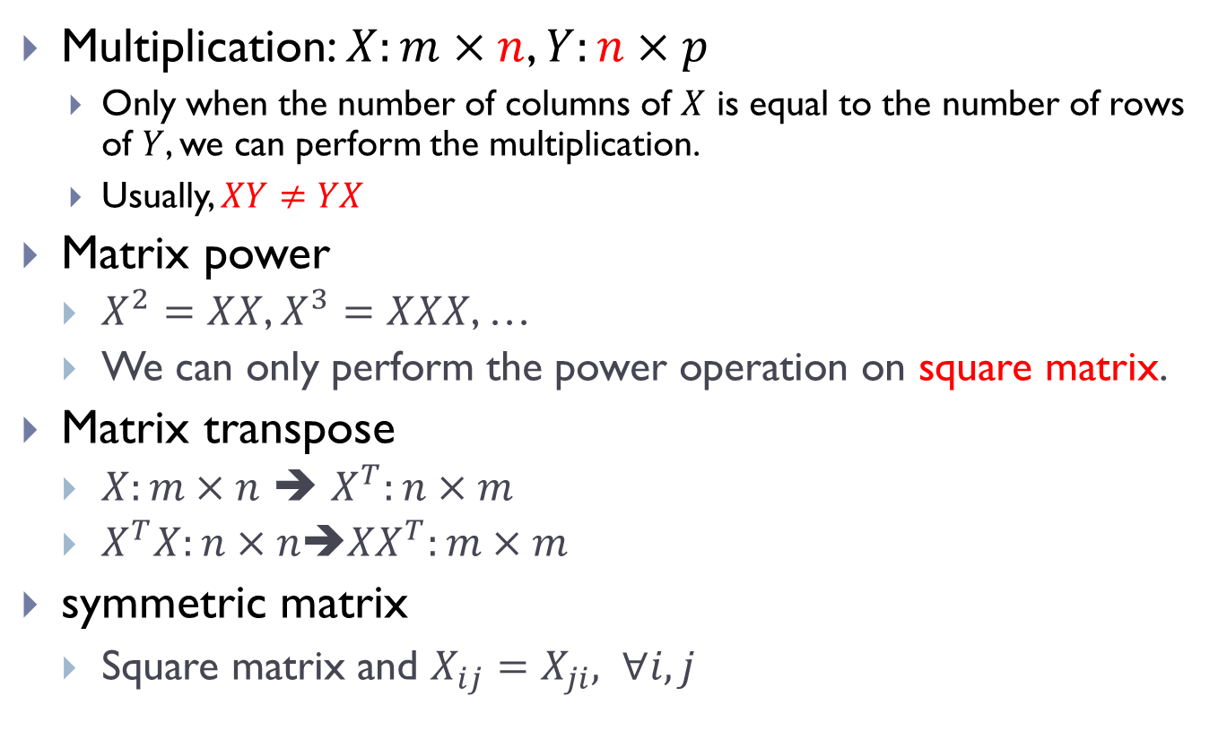
Matrix operations
Multiplication: $X:m×n$, $Y:n×p$
Only when the number of columns of $X$ is equal to the number of rows of $Y$, we can perform the multiplication.
Usually, $XY≠YX$
Matrix power
$X^{2}=XX$, $X^{3}=XXX$, …
We can only perform the power operation on square matrix.
Matrix transpose
$X:m×n$ ➔ $X^{T}:n×m$
$X^{T}X:n×n$➔${XX}^{T}:m×m$
symmetric matrix
Square matrix and $X_{ij}=X_{ji}, ∀i,j$

Slide 9
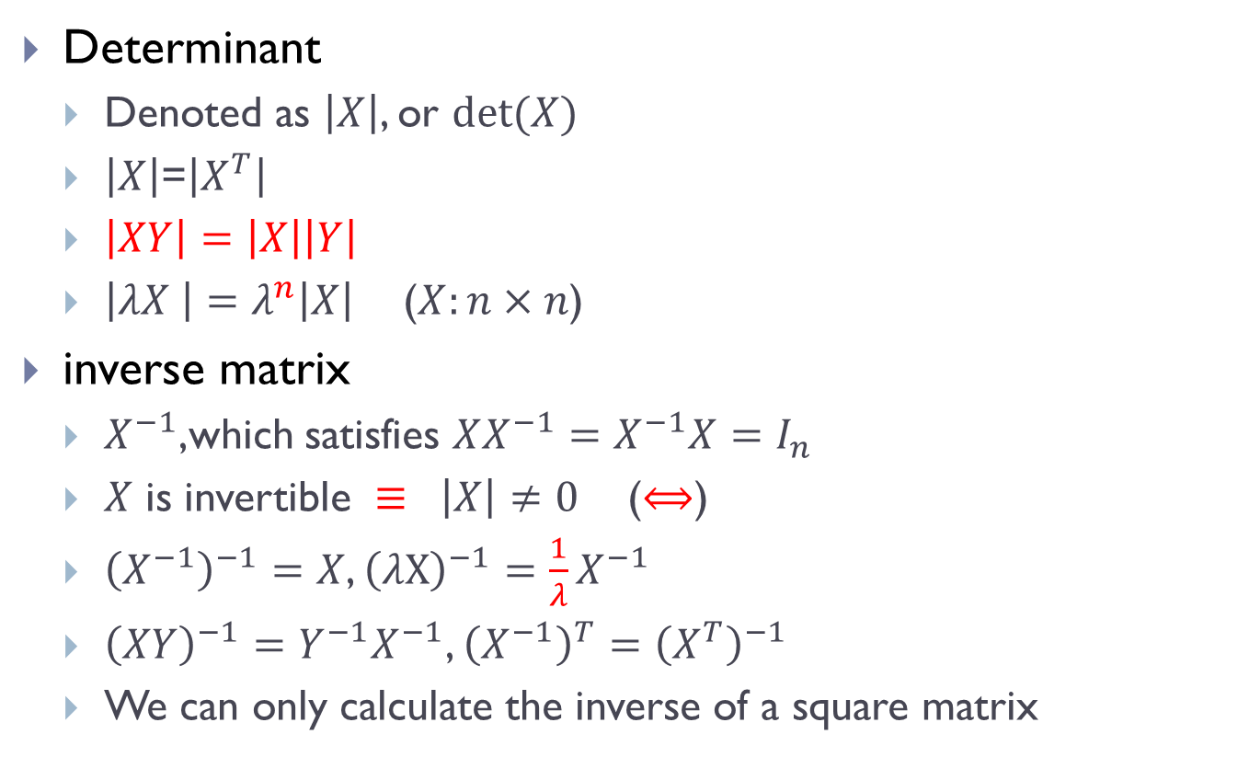
Matrix operations
Determinant
Denoted as $\left|X\right|$, or $det⁡(X)$
$\left|X\right|$=$\left|X^{T}\right|$
$\left|XY\right|=\left|X\right|\left|Y\right|$
$\left|λX \right|=λ^{n}\left|X\right|$ ($X:n×n$)
inverse matrix
$X^{−1}$,which satisfies $XX^{−1}=X^{−1}X=I_{n}$
$X$ is invertible $≡ \left|X\right|≠0$ ($⟺$)
${\left(X^{−1}\right)}^{−1}=X$, ${\left(λX\right)}^{−1}=\frac{1}{λ}X^{−1}$
${\left(XY\right)}^{−1}=Y^{−1}X^{−1}$, ${\left(X^{−1}\right)}^{T}={\left(X^{T}\right)}^{−1}$
We can only calculate the inverse of a square matrix

Slide 10
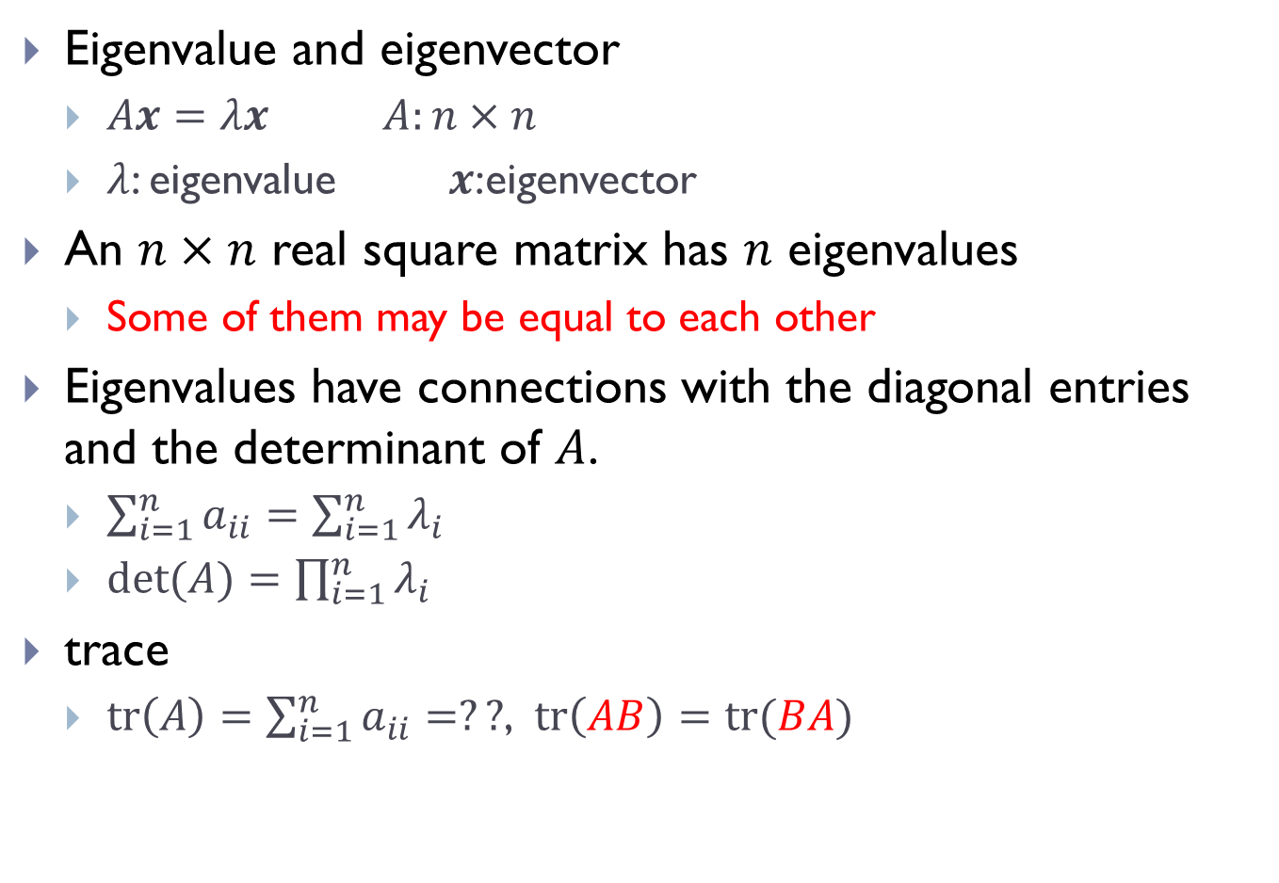
Eigenvalue, eigenvector, rank and trace
Eigenvalue and eigenvector
$Ax=λx$ $A:n×n$
$λ$: eigenvalue $x$:eigenvector
An $n×n$ real square matrix has $n$ eigenvalues
Some of them may be equal to each other
Eigenvalues have connections with the diagonal entries and the determinant of $A$.
$\sum_{i=1}^{n}{a_{ii}}=\sum_{i=1}^{n}{λ_{i}}$
$det⁡(A)=\prod_{i=1}^{n}{λ_{i}}$
trace
$tr\left(A\right)=\sum_{i=1}^{n}{a_{ii}=??}$, $tr\left(AB\right)=tr(BA)$

Slide 11
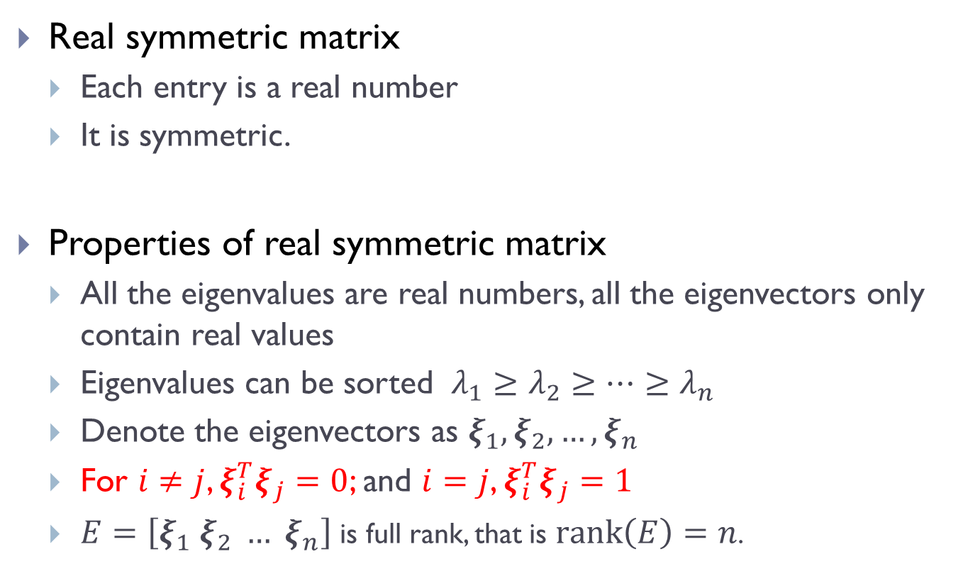
Real symmetric matrix
Real symmetric matrix
Each entry is a real number
It is symmetric.
Properties of real symmetric matrix
All the eigenvalues are real numbers, all the eigenvectors only contain real values
Eigenvalues can be sorted $λ_{1}≥$ $λ_{2}≥…≥λ_{n}$
Denote the eigenvectors as $ξ_{1},ξ_{2},…,ξ_{n}$
For $i≠j$, $ξ_{i}^{T}ξ_{j}=0$; and $i=j$, $ξ_{i}^{T}ξ_{j}=1$
$E=\left[ξ_{1} ξ_{2} … ξ_{n}\right]$ is full rank, that is $rank\left(E\right)=n$.

Slide 12
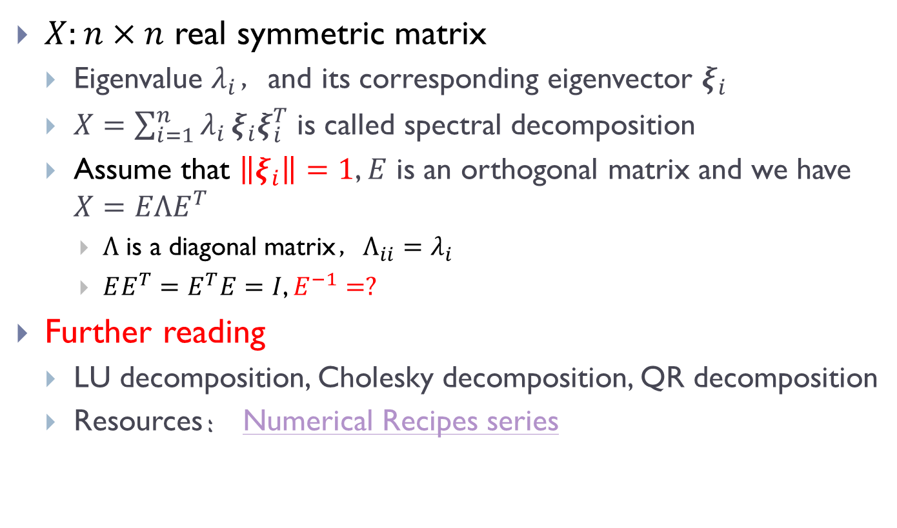
The decomposition of RSM
$X:n×n$ real symmetric matrix
Eigenvalue $λ_{i}$，and its corresponding eigenvector $ξ_{i}$
$X=\sum_{i=1}^{n}{λ_{i}}ξ_{i}ξ_{i}^{T}$ is called spectral decomposition
Assume that $\left\|ξ_{i}\right\|=1$, $E$ is an orthogonal matrix and we have $X=EΛE^{T}$
$Λ$ is a diagonal matrix，$Λ_{ii}=λ_{i}$
$EE^{T}=E^{T}E=I$, $E^{−1}=?$
Further reading
LU decomposition, Cholesky decomposition, QR decomposition
Resources： Numerical Recipes series

Slide 13
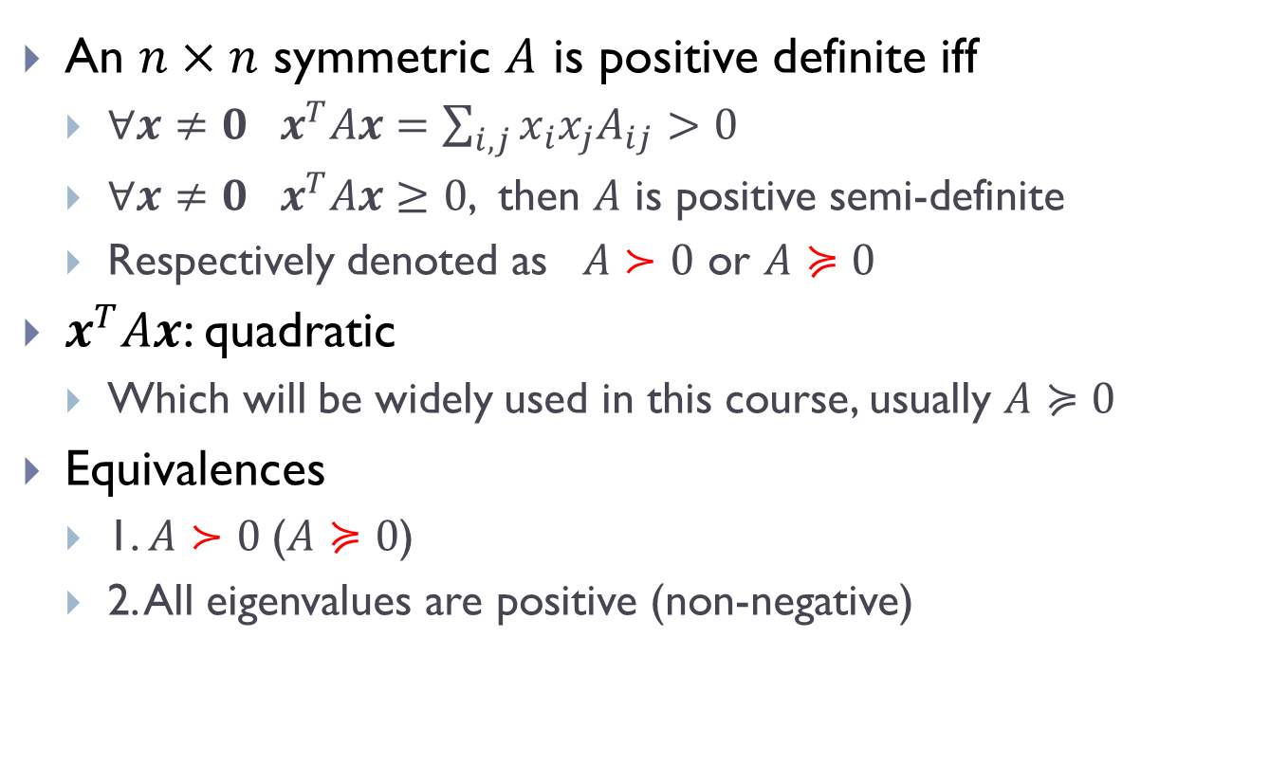
Positive (semi-)definite RSM
An $n×n$ symmetric $A$ is positive definite iff
$∀x≠0 x^{T}Ax=\sum_{i,j}{x_{i}x_{j}A_{ij}}>0$
$∀x≠0 x^{T}Ax≥0$, then $A$ is positive semi-definite
Respectively denoted as $A≻0$ or $A≽0$
$x^{T}Ax$: quadratic
Which will be widely used in this course, usually $A≽0$
Equivalences
1. $A≻0$($A≽0$)
2. All eigenvalues are positive (non-negative)

Slide 14
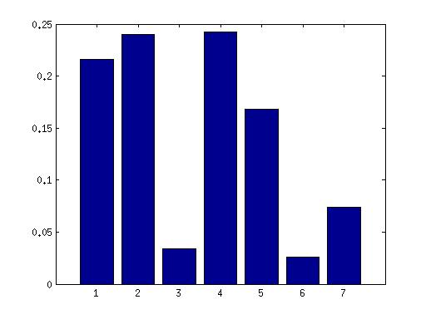
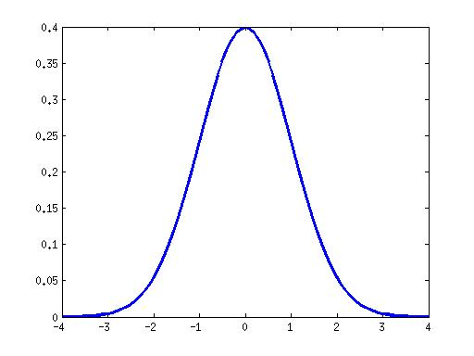
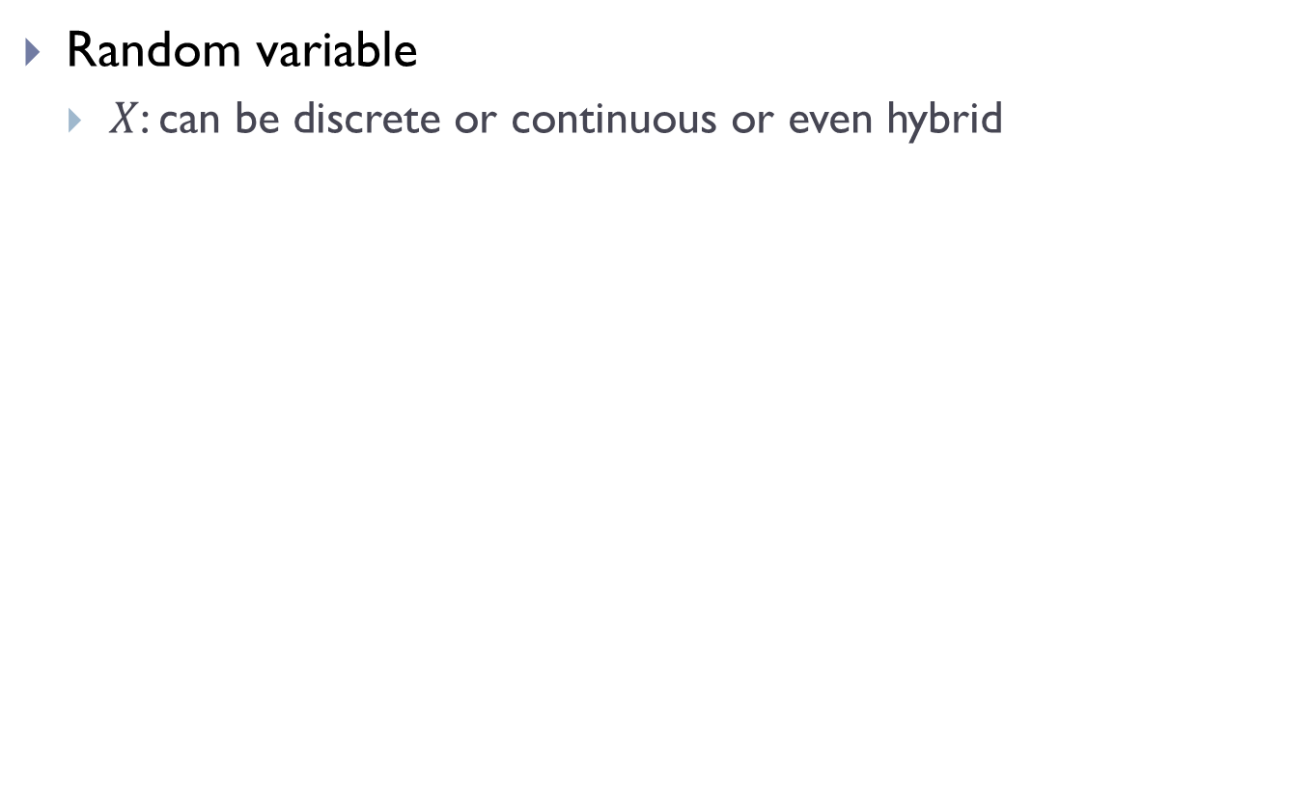
Probability & Statistics
Random variable
$X$: can be discrete or continuous or even hybrid
Notes:
Discrete: a=rand(1,7);a=a/sum(a);bar(a)
Continuous: plot([-4:0.1:4],normpdf([-4:0.1:4],0,1),'LineWidth',3)

Slide 15
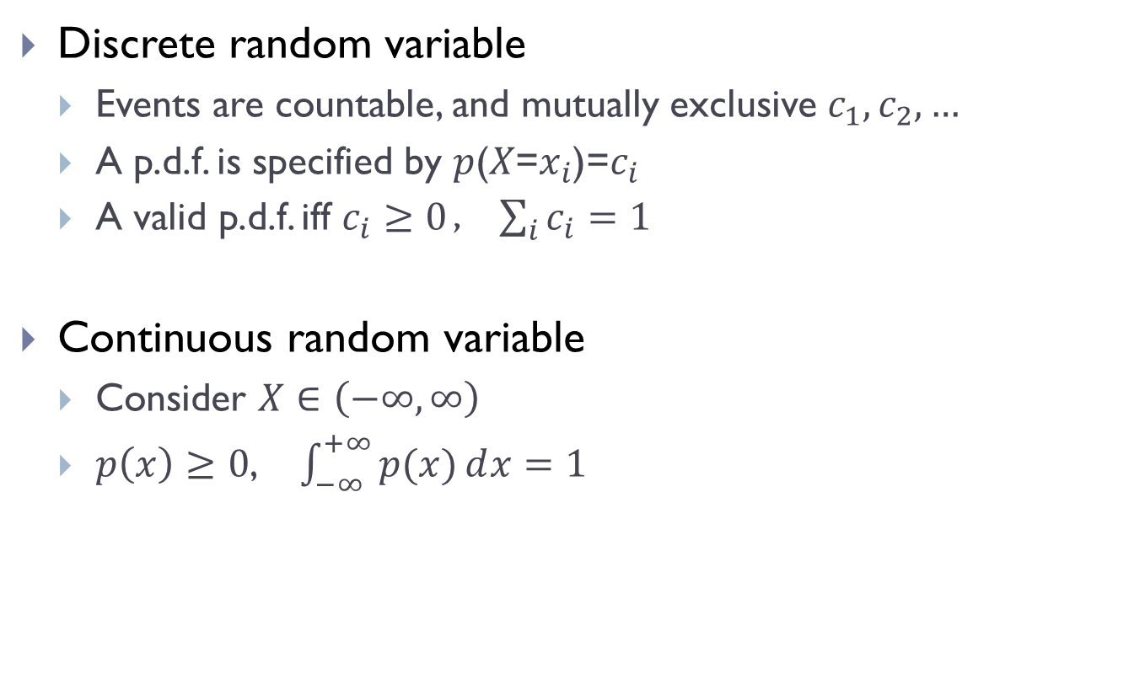
Probabilistic Density Function (PDF)
Discrete random variable
Events are countable, and mutually exclusive $c_{1},c_{2},…$
A p.d.f. is specified by 𝑝(𝑋=$x_{i}$)=$c_{i}$
A valid p.d.f. iff $c_{i}≥0$， $\sum_{i}{c_{i}=1}$
Continuous random variable
Consider $X∈\left(−∞,∞\right)$
$p\left(x\right)≥0$, $\int_{−∞}^{+∞}{p(x)ⅆx}=1$

Slide 16
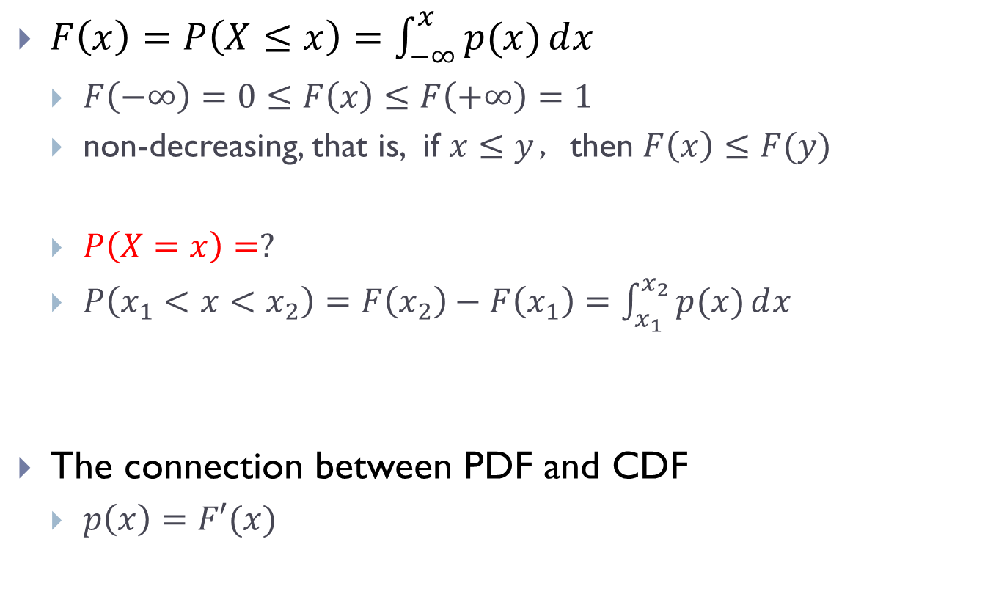
Cumulative distribution function (c.d.f.)
$F\left(x\right)=P\left(X≤x\right)=\int_{−∞}^{x}{p(x)ⅆx}$
$F\left(−∞\right)=0≤F\left(x\right)≤F\left(+∞\right)=1$
non-decreasing, that is, if $x≤y$，then $F\left(x\right)≤F(y)$
$P\left(X=x\right)=?$
$P\left(x_{1}<x<x_{2}\right)=F\left(x_{2}\right)−F\left(x_{1}\right)=\int_{x_{1}}^{x_{2}}{p(x)ⅆx}$
The connection between PDF and CDF
$p\left(x\right)=F′(x)$

Slide 17
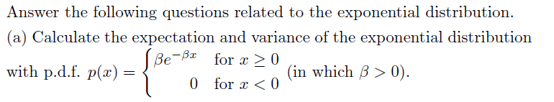
From PDF to CDF
Example

Slide 18
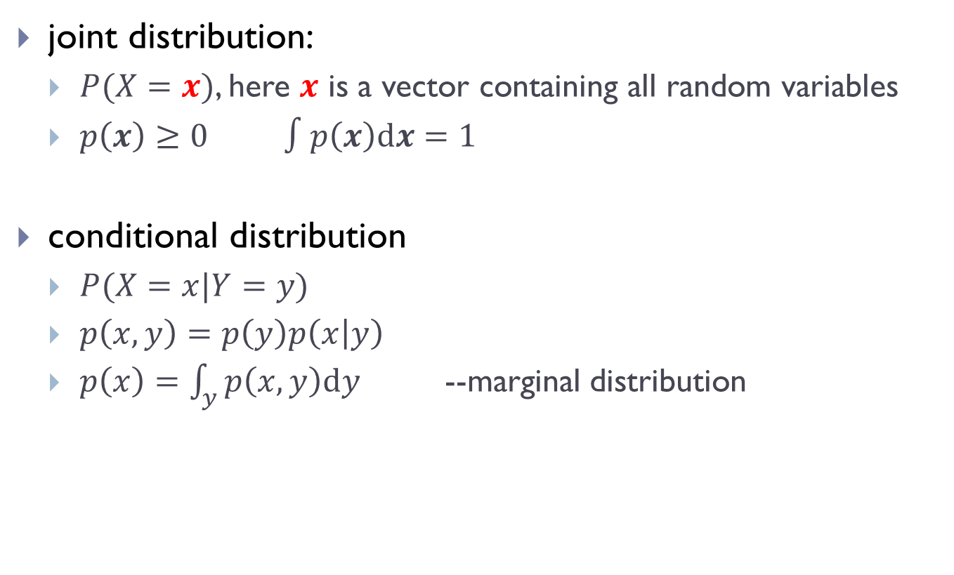
Joint and conditional distributions
joint distribution:
$P(X=x)$, here $x$ is a vector containing all random variables
$p\left(x\right)≥0$ $∫p\left(x\right)dx=1$
conditional distribution
$P(X=x|Y=y)$
$p\left(x,y\right)=p\left(y\right)p\left(x | y\right)$
$p\left(x\right)=\int_{y}{p\left(x,y\right)dy}$ --marginal distribution

Slide 19
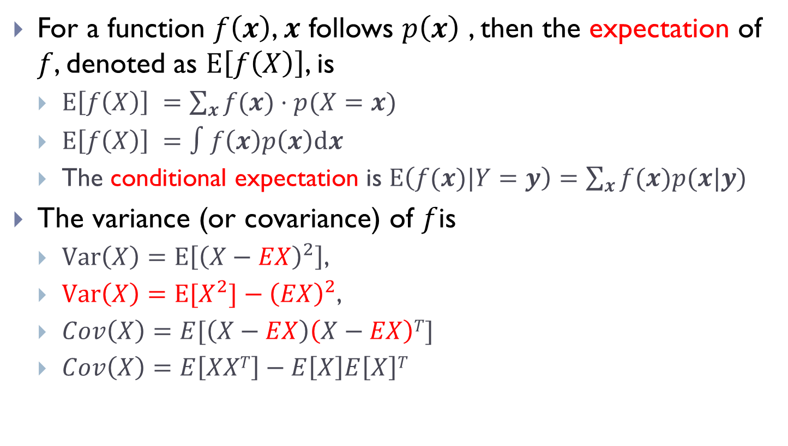
Expectation
For a function $f\left(x\right)$, $x$ follows $p\left(x\right)$ , then the expectation of $f$, denoted as $E\left[f\left(X\right)\right]$, is
$E\left[f\left(X\right)\right] =\sum_{x}{f(x)⋅p(X=x)}$
$E\left[f\left(X\right)\right] =∫f\left(x\right)p\left(x\right)dx$
The conditional expectation is $E\left(f(x)|Y=y\right)=\sum_{x}{f(x)p(x|y)}$
The variance (or covariance) of $f$is
$Var\left(X\right)=E\left[{\left(X−EX\right)}^{2}\right]$,
$Var\left(X\right)=E[X^{2}]−{\left(EX\right)}^{2}$,
$Cov\left(X\right)=E[\left(X−EX\right)\left(X−EX\right)T]$
$Cov\left(X\right)=E\left[XXT\right]−E\left[X\right]E\left[X\right]T$

Slide 20
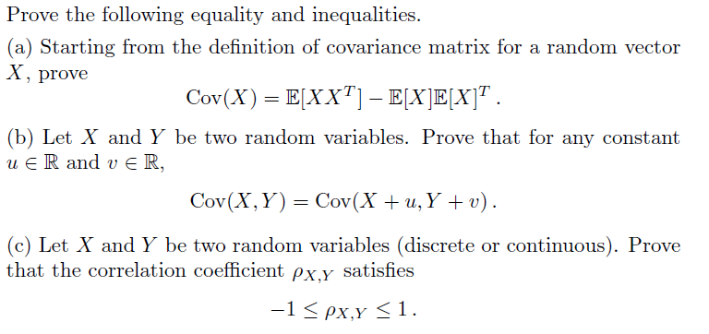
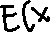
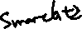


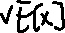
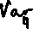
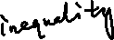





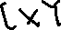
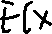
Example
Example

Slide 21
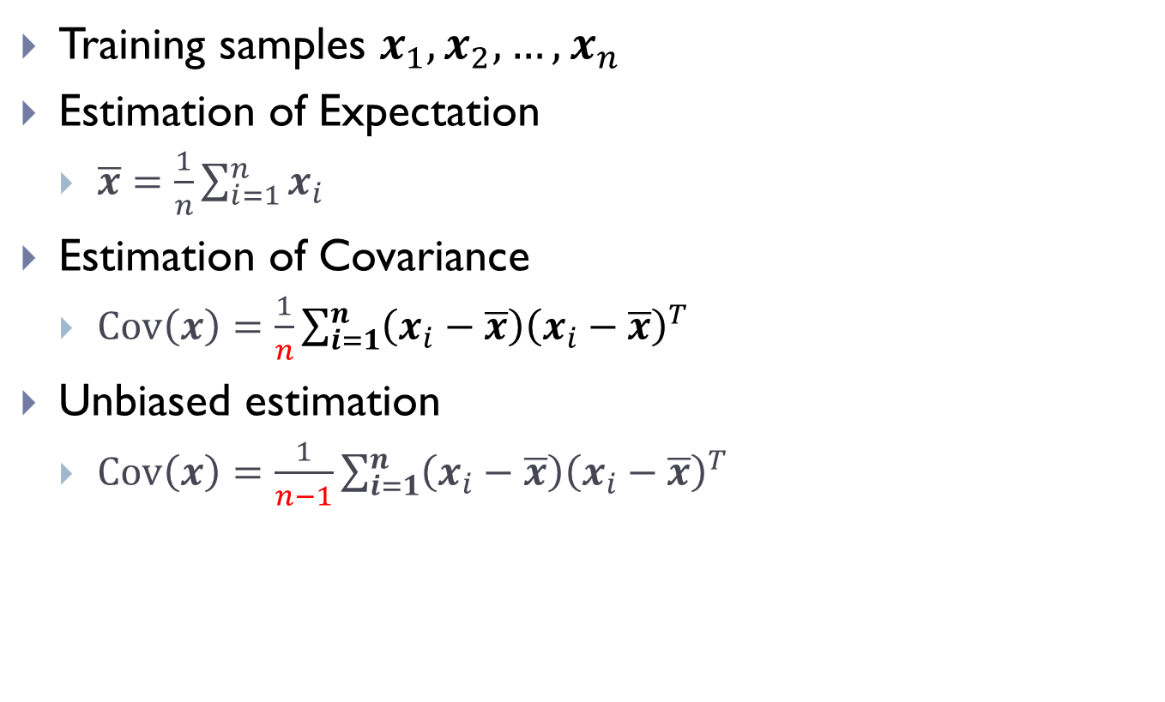



Estimation to Expectation & Covariance
Training samples $x_{1},x_{2},…,x_{n}$
Estimation of Expectation
$\overline{x}=\frac{1}{n}\sum_{i=1}^{n}{x_{i}}$
Estimation of Covariance
$Cov\left(x\right)=\frac{1}{n}\sum_{i=1}^{n}{{\left(x_{i}−\overline{x}\right)\left(x_{i}−\overline{x}\right)}^{T}}$
Unbiased estimation
$Cov\left(x\right)=\frac{1}{n−1}\sum_{i=1}^{n}{{\left(x_{i}−\overline{x}\right)\left(x_{i}−\overline{x}\right)}^{T}}$

Slide 22
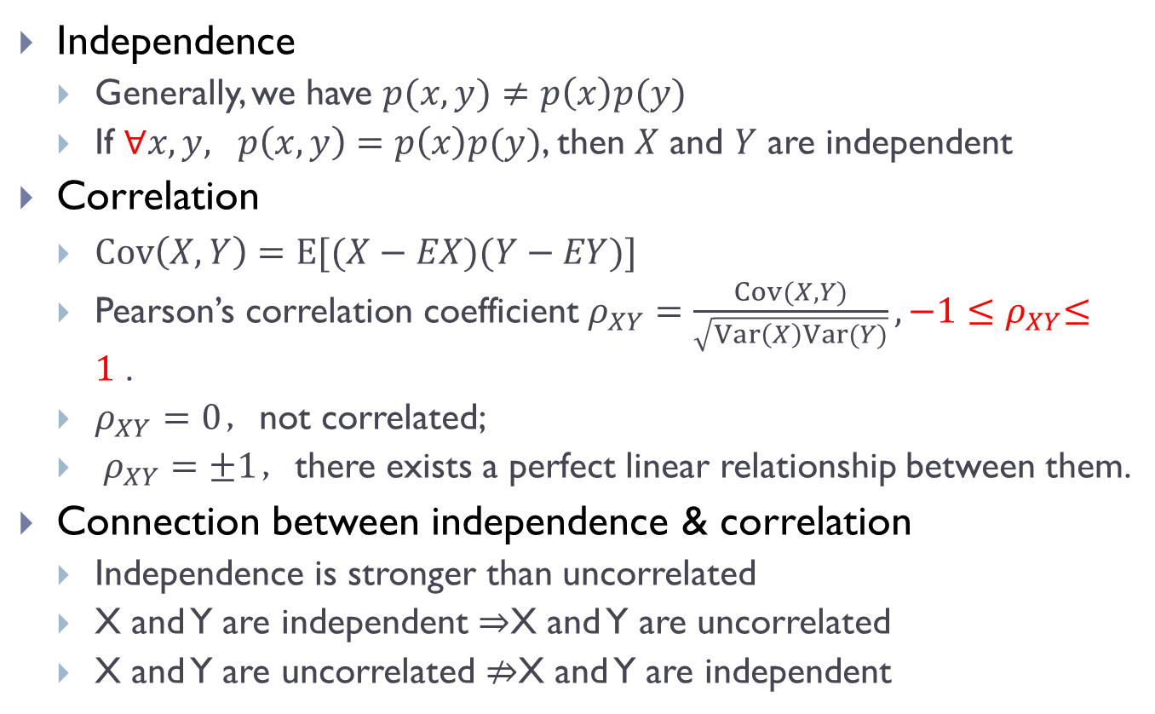
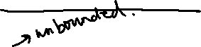

Independence & Correlation
Independence
Generally, we have $p(x,y)≠p\left(x\right)p(y)$
If $∀x,y, p\left(x,y\right)=p\left(x\right)p(y)$, then $X$ and $Y$ are independent
Correlation
$Cov\left(X,Y\right)=E[(X−EX)(Y−EY)]$
Pearson’s correlation coefficient$ρ_{XY}=\frac{Cov(X,Y)}{\sqrt{Var\left(X\right)Var(Y)}},{−1≤ρ}_{XY}≤1$ .
$ρ_{XY}=0$，not correlated;
$ρ_{XY}=±1$，there exists a perfect linear relationship between them.
Connection between independence & correlation
Independence is stronger than uncorrelated
X and Y are independent $⇒$X and Y are uncorrelated
X and Y are uncorrelated $⇏$X and Y are independent

Slide 23

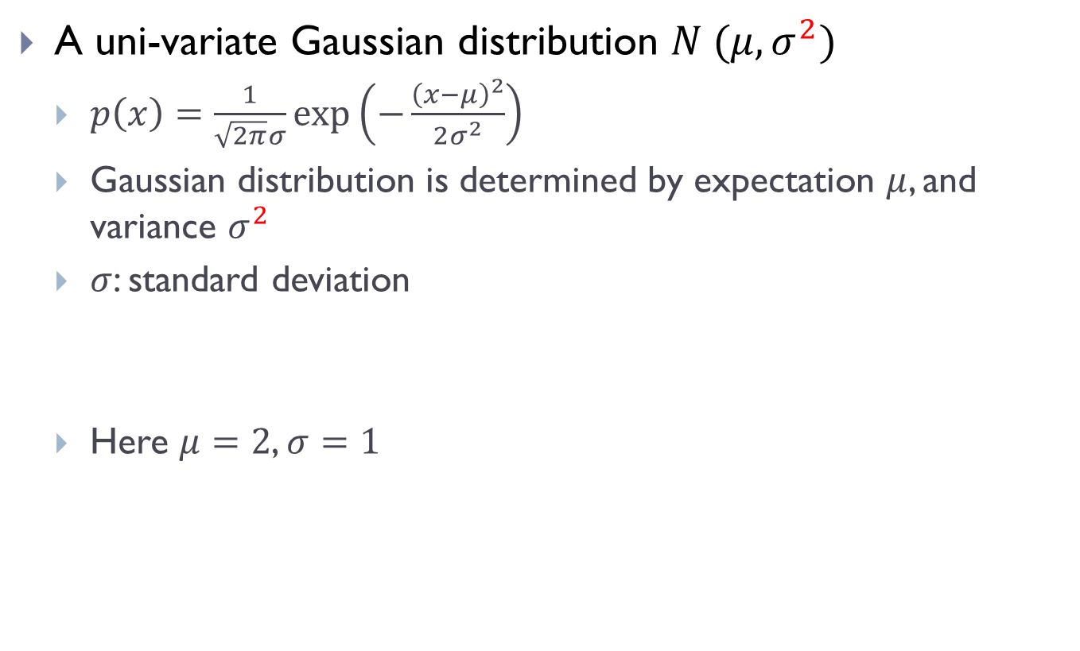
Gaussian distribution
A uni-variate Gaussian distribution $N (μ,σ^{2})$
$p\left(x\right)=\frac{1}{\sqrt{2π}σ}\exp\left(−\frac{{\left(x−μ\right)}^{2}}{2σ^{2}}\right)$
Gaussian distribution is determined by expectation $μ$, and variance $σ^{2}$
$σ$: standard deviation
Here $μ=2$, $σ=1$
Notes:
plot([-4:0.1:4]+2,normpdf([-4:0.1:4],0,1),'LineWidth',3)

Slide 24
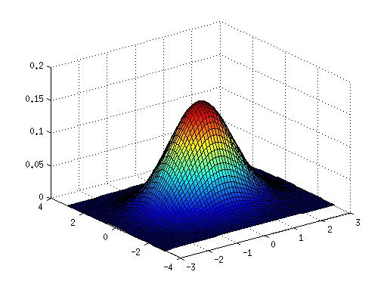
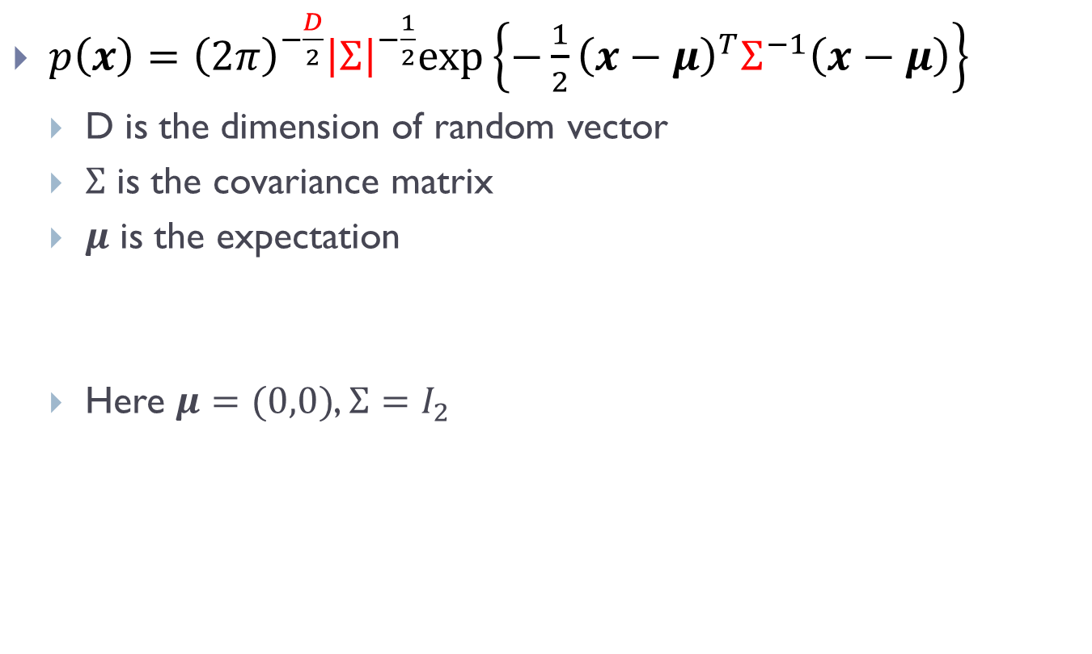
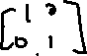
Multivariate Gaussian distribution
$p\left(x\right)={\left(2π\right)}^{−\frac{D}{2}}{\left|Σ\right|}^{−\frac{1}{2}}exp⁡\left\{−\frac{1}{2}{\left(x−μ\right)}^{T}Σ^{−1}\left(x−μ\right)\right\}$
D is the dimension of random vector
$Σ$ is the covariance matrix
$μ$ is the expectation
Here $μ=(0,0)$, $Σ=I_{2}$
Notes:
[x, y] = meshgrid(-3:0.1:3,-3:0.1:3);
z=1/(2*pi)*exp(-.5*(x.*x+y.*y));
surf(x,y,z)

Slide 25
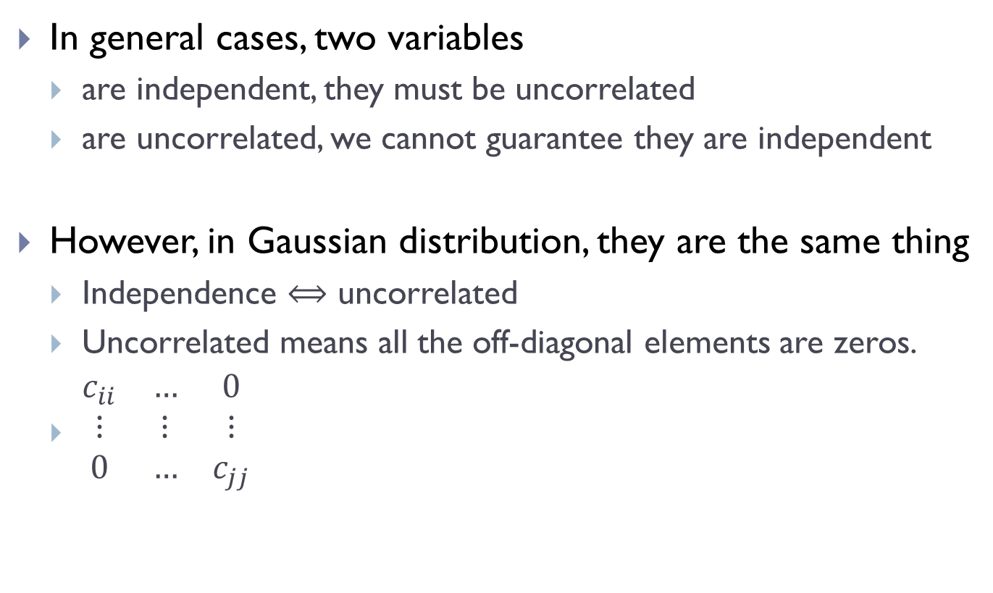

Independence & Correlation in G.D.
In general cases, two variables
are independent, they must be uncorrelated
are uncorrelated, we cannot guarantee they are independent
However, in Gaussian distribution, they are the same thing
Independence $⟺$ uncorrelated
Uncorrelated means all the off-diagonal elements are zeros.
$\begin{matrix}c_{ii} & … & 0 \\ ⋮ & ⋮ & ⋮ \\ 0 & … & c_{jj}\end{matrix}$

Slide 26
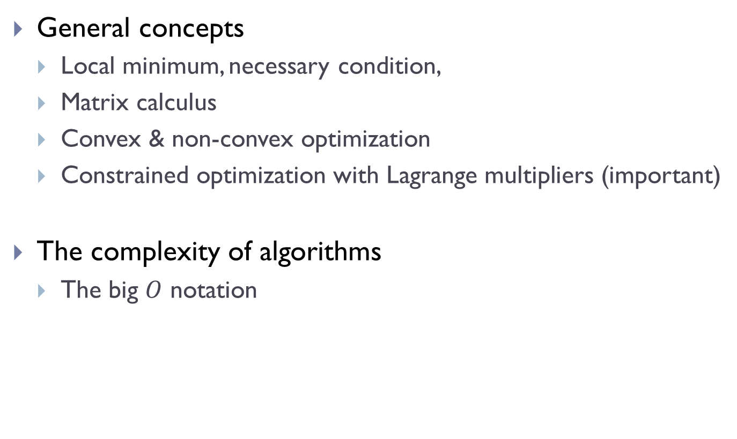
Optimization & matrix calculus
General concepts
Local minimum, necessary condition,
Matrix calculus
Convex & non-convex optimization
Constrained optimization with Lagrange multipliers (important)
The complexity of algorithms
The big $O$ notation

